Slide 1
DATA INTEGRITY AND TRANSACTIONS
By Satyam Kumar Maurya

Slide 2
What is Data Integrity
Data integrity is data’s accuracy, completeness, consistency, and validity over its entire life cycle. Data integrity ensures that data stored in a database is accurate, consistent, and reliable throughout its lifecycle.

Slide 3
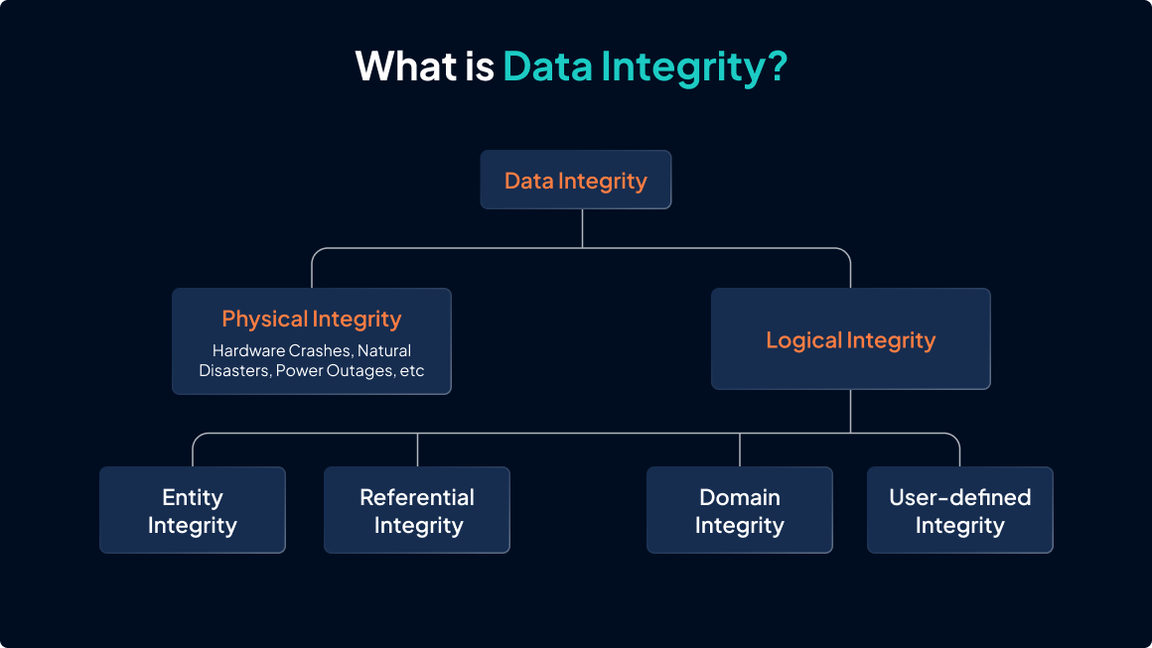

Slide 4
What is transaction?
A transaction groups one or more database operations into a single logical unit of work that must either fully succeed or fully fail.
A transaction consists of a sequence of operations such as INSERT, UPDATE, DELETE, or SELECT.
Commonly used in banking systems, e-commerce, applications, and reservation systems.

Slide 5
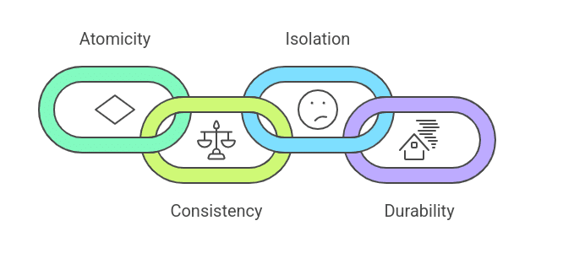
ACID Properties

Slide 6
ACID Properties Brief
Atomicity : Ensures that all operations in a transaction are completed. If any operation fails, the entire transaction is rolled back.
Consistency : Ensures that a transaction transforms the database from one valid state to another while enforcing constraints.

Slide 7
ACID Properties Brief
Isolation: Ensures that concurrent transactions do not affect each other.
Durability: Ensures that committed data is permanently saved.

Slide 8
Isolation Levels
Isolation levels define how database transactions interact with each other when they are executed concurrently.
They determine the degree to which one transaction can see the changes made by another transaction before it is committed.
Isolation levels are essential for balancing data consistency, concurrency, and system performance.

Slide 9
Read Uncommitted
Read Uncommitted is the lowest isolation level. This isolation level provides high performance but very low data reliability and is rarely used in practice.
At this level, a transaction can read data that has been modified by another transaction but not yet committed.
This can lead to problems such as:
- Dirty Reads
- Inconsistent data results

Slide 10
Read Committed
Read Committed ensures that a transaction can only read data that has already been committed. This prevents dirty reads and improves data reliability.
However, this level allows:
- Non-repeatable reads
- Data changes between queries
Read Committed is commonly used as the default isolation level in many relational database systems.

Slide 11
Repeatable Read
Repeatable Read isolation level ensures that once a transaction reads a row, the same data is returned if it is read again within the same transaction.
This isolation level prevents Dirty Reads & Non-Repeatable Reads
However, it may still allow phantom reads, where new rows matching a query condition appear during the transaction.
Repeatable Read provides a balance between data consistency and system performance.

Slide 12
Serializable
Serializable is the highest isolation level in a database system. It ensures complete isolation between transactions by making them execute as if they were run one after another in a sequence.
This isolation level prevents Dirty Reads, Non-Repeatable Reads, Phantom Reads
Serializable guarantees maximum data consistency but may
significantly reduce performance due to strict locking
and reduced concurrency.

Slide 13
THANK YOU

